Slide 1
SmartCare pro job aid
STEPS ON HOW TO PROVIDE CERVICAL CANCER SERVICE IN SMARTCARE PRO

Slide 2
Introduction
The Cervical Cancer Module is a new Module in SmartCare Pro that is used for screening, investigations, diagnosis and treatment of cervical cancer, including referral for further management.

Slide 3
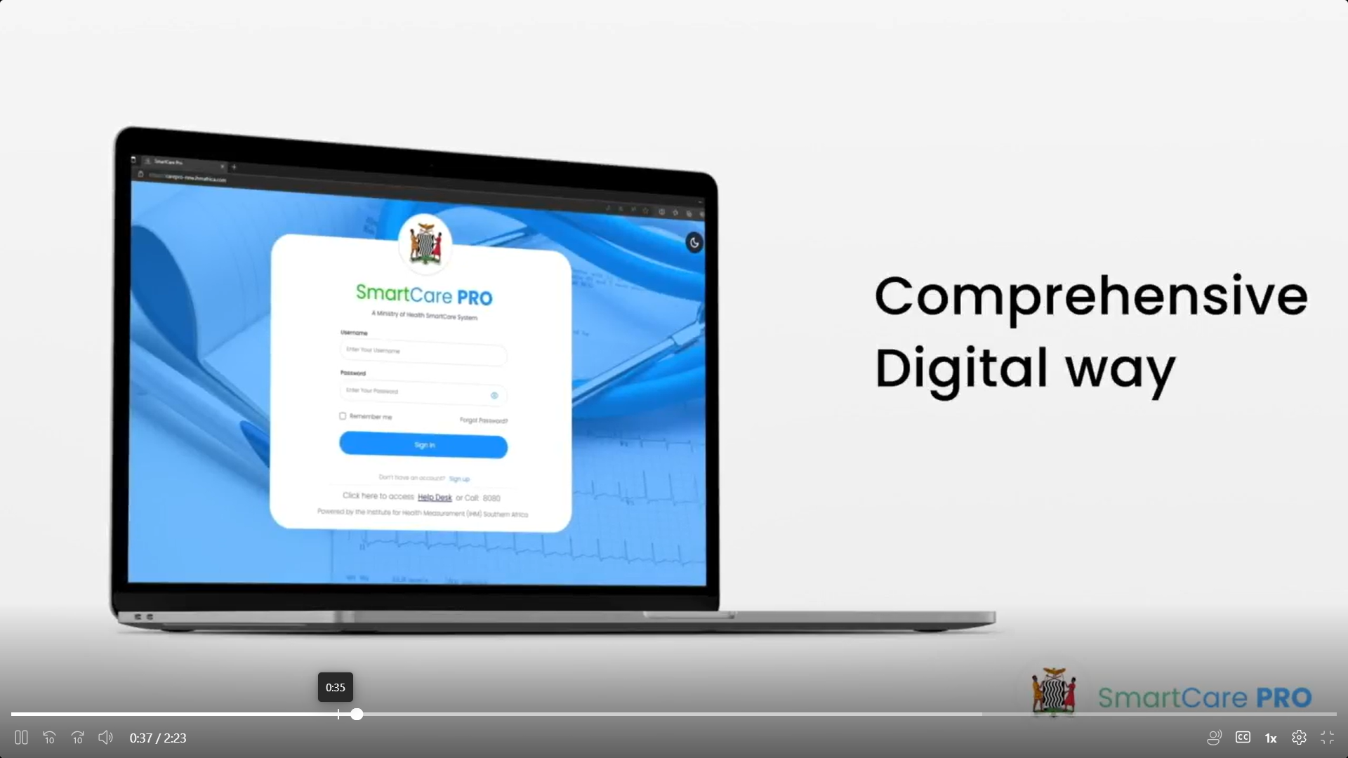
Objectives
At the end of this module, you are expected to:
Provide pre-screening service to a client.
Screen for cervical cancer including investigations and diagnosis.
Treat Cervical cancer, including referral for further management.

Slide 4
Nyuma Mapalo is a Registry Clerk at Kalulushi General Hospital. Nyuma has a client who has come at the facility seeking medical attention. Nyuma asks the client if this is their first visit, the client tells Nyuma that it is not their first time coming to the facility. Nyuma realizes that the client is already registered in the system. Nyuma will now search for the client following the steps that follow.

Slide 5
Step 1
The first step that Nyuma will take is login into SmartCare Pro, she will land on the, “search client”, page as seen in the picture

Slide 6
Step 2
NRC
Cellphone
Name Search
NUPN
On the search page, Nyuma will search for the client either by their;
Biometrics (fingerprints).
NRC,
NUPN,
Cellphone OR
Name search will allow Nyuma to search the client by either their first name, surname, sex or Date of birth.

Slide 7
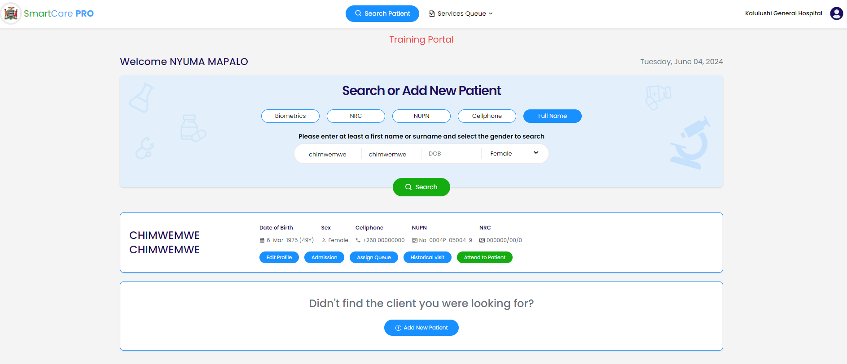
Step 3
When Nyuma clicks the search icon, a file will appear at the bottom of the page and will look like this…
This part also will allow Nyuma to Register the client if she is not in the system.

Slide 8
STEP 4
Nyuma will now click Assign to service queue icon to send the client for appropriate service.
This can be done by either clicking the Assign client or on the service queue at the top.

Slide 9
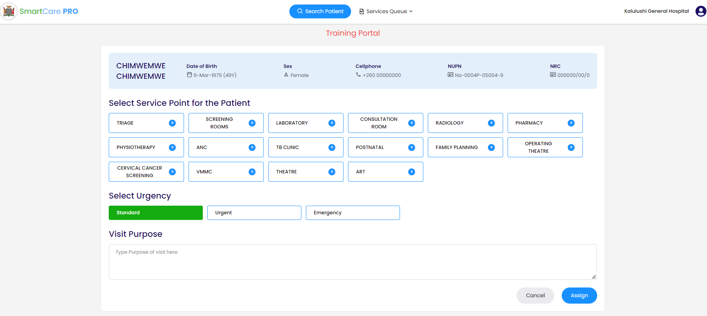
STEP 4
Nyuma then Assigns her client to Cervical Cancer Service Point as Standard (green) for the purpose of Cervical Cancer Management.
As a Registry Clerk, Nyuma’s job ends at assigning. After that she will click on the search patient button at the top and attend to the next client.

Slide 10
This is Jessie Muusa. Jessie is a Registered Midwife specialized in Cervical Cancer at Kalulushi Gen Hospital.
Jessie is a SmartCare Pro first time user learning how to use the cervical cancer module. Jessie will have to follow these easy steps to learn how to navigate through the cervical cancer module.

Slide 11
Step 1
Jessie will open the cervical cancer service queue and find one client assigned to her.

Slide 12
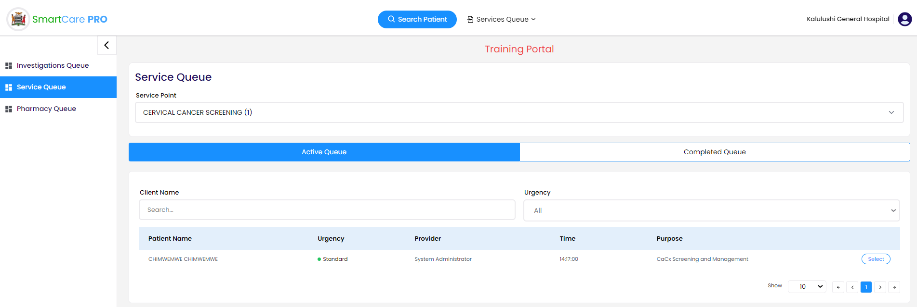
Step 2
Jessie will then select the assigned client using the select button.

Slide 13
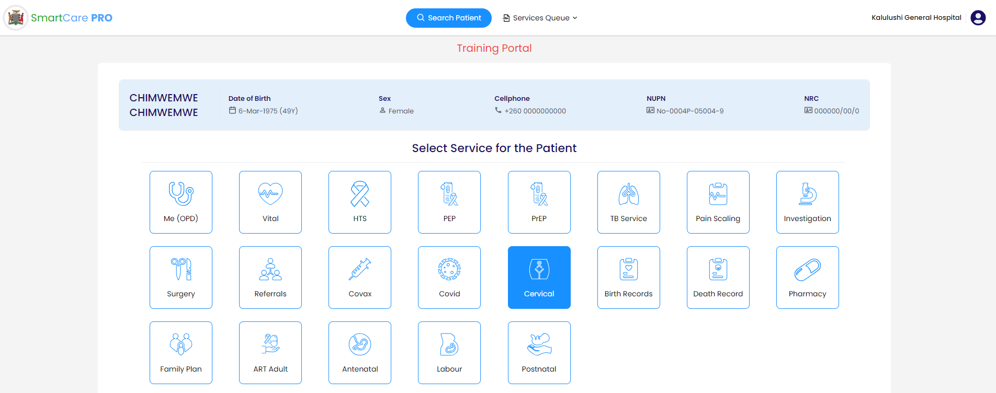
Step 3
Jessie will click on Cervical Cancer Service

Slide 14
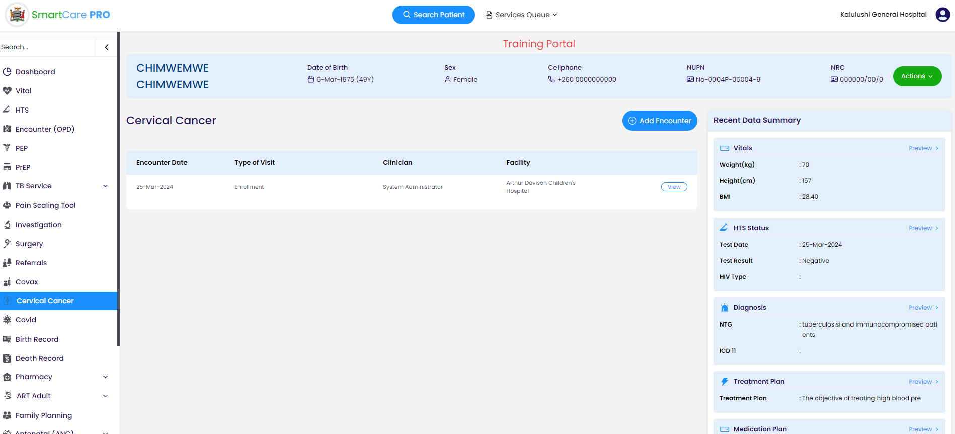
Step 4
Jessie will click on the Add Encounter Button to start navigating through the Cervical Cancer Module.
On this page past visits can be seen by : Date, Type of visit, Reviewing clinician, Facility at which client seen

Slide 15
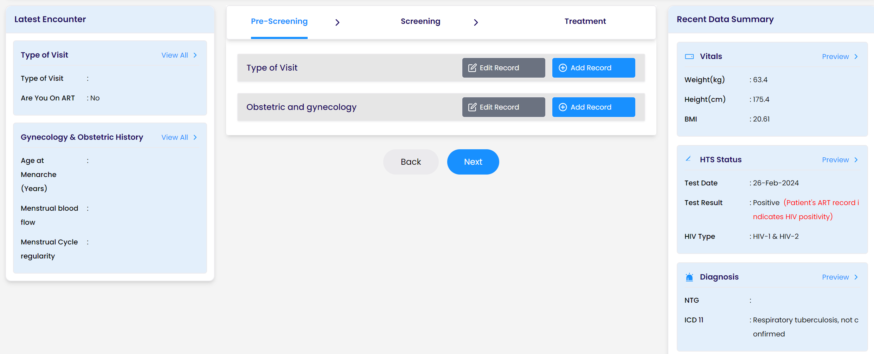
Step 5
Pre-Screening
Enter and Save Type of Visit RecordVitals,
The side dashboards show, HIV status, HIV test date,Visit Type, ART status, Obs & Gyn History. The system automatically greys out if the client is HIV +, i.e,Greys out if client is HIV+: ART status, HIV status, Last HIV test date

Slide 16
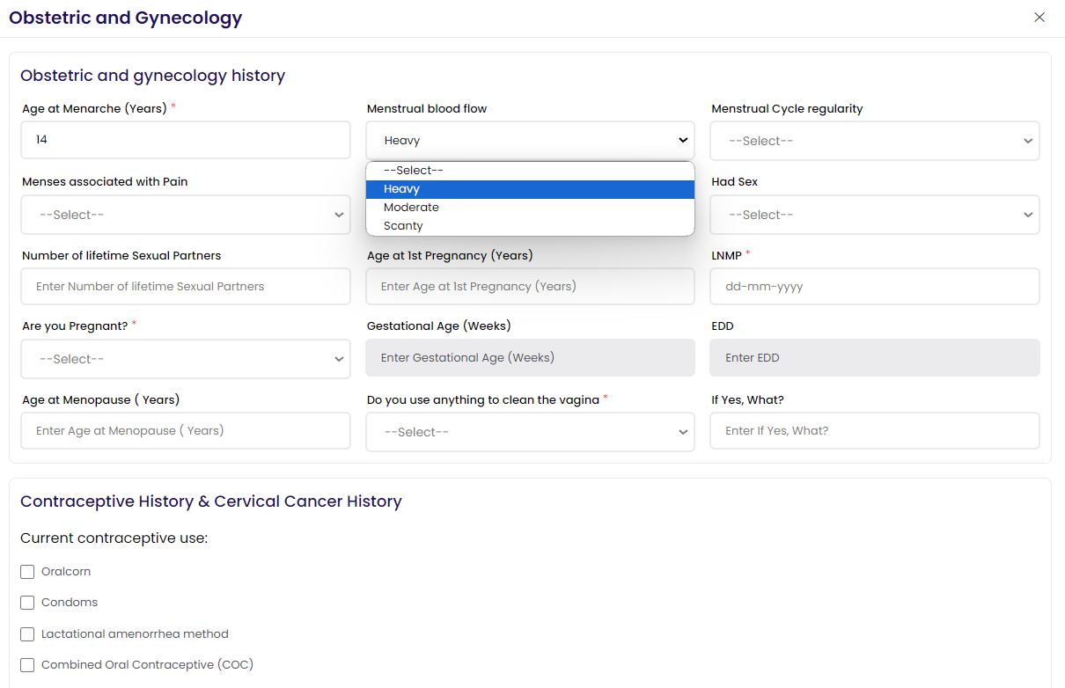
Step 6
Pre-Screening
Start entering Obstetric and Gynecology Record. This also includes the Contraceptive History, Previous screening history, Screening questions for cervical lesions.

Slide 17
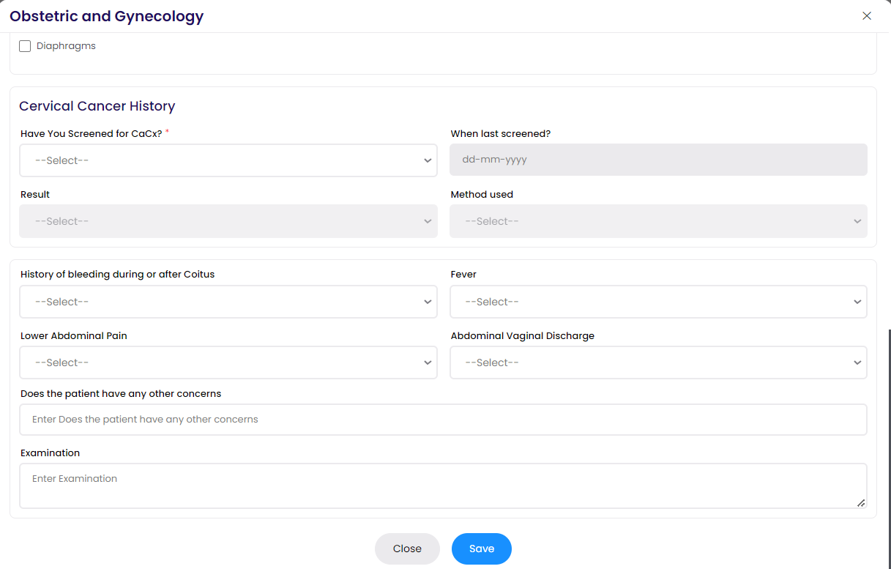
Step 7
Pre-Screening
Continue entering and Save Obstetric and Gynecology Record
Click Next to proceed to Screening

Slide 18
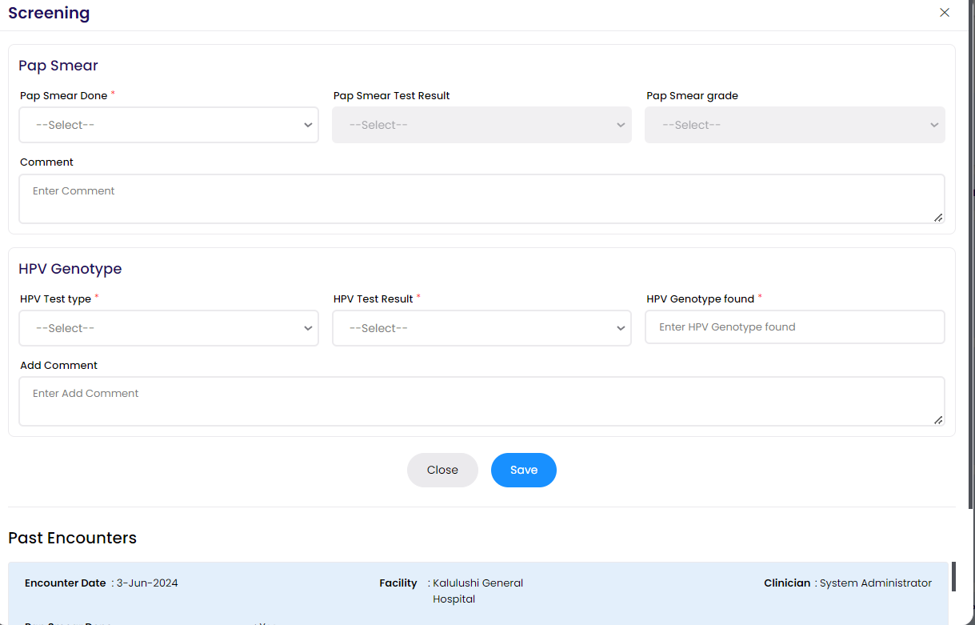
Step 8
Screening
Enter and Save Pap Smear screening Record
Click Next to proceed to Treatment

Slide 19
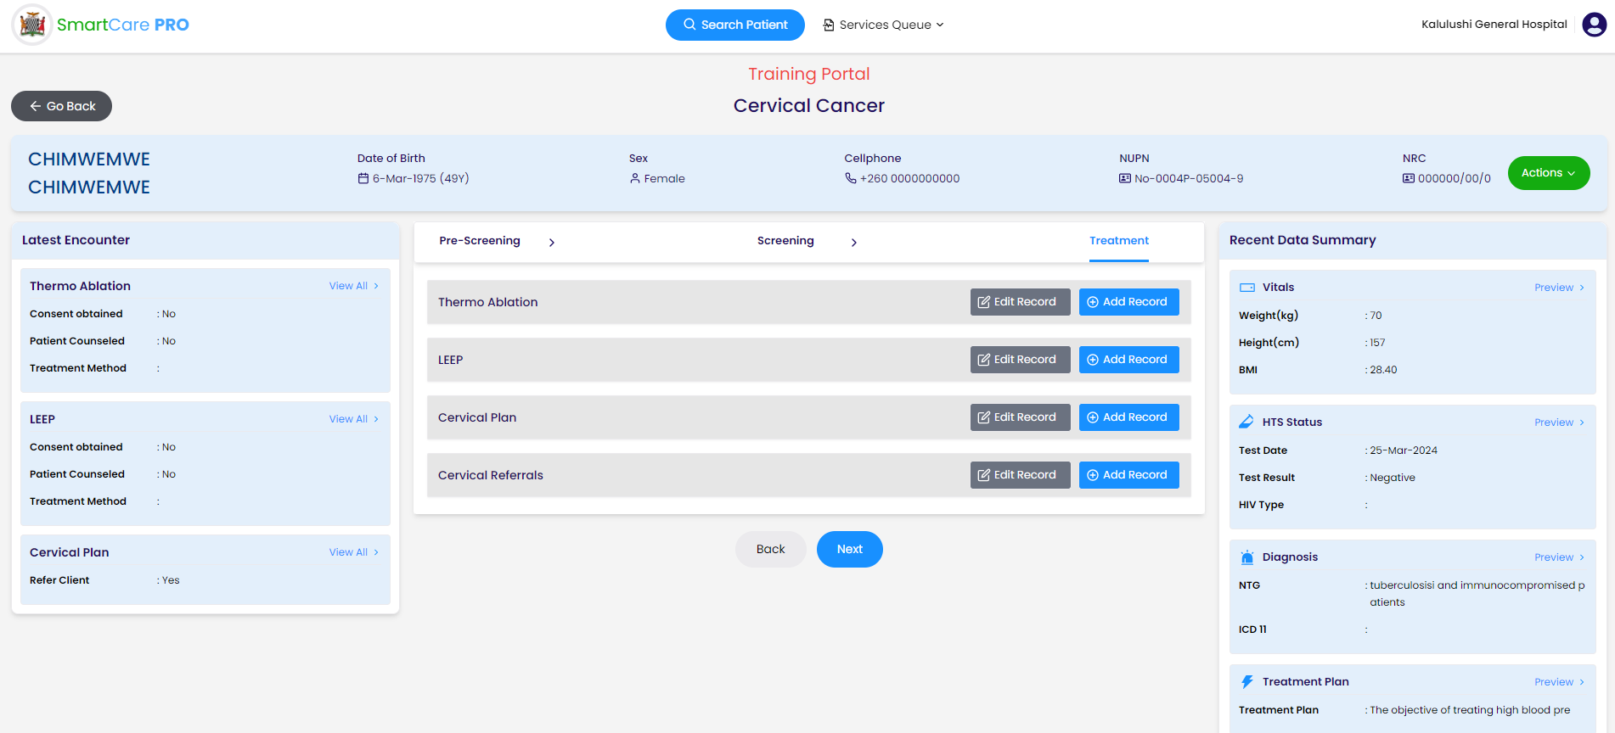
Step 9
Treatment
Enter and Save Thermo Ablation Record
Enter and Save LEEP Record
Enter and Save Cervical Plan Record

Slide 20
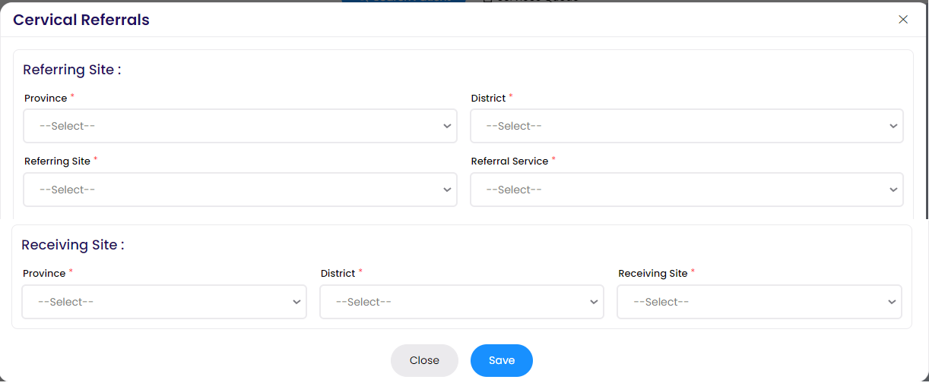
Step 10
Treatment
Enter and Save Cervical Referral Record if referring.

Slide 21
Conclusion
Once Jessie completes all interactions with her client, she will either commence appropriate treatment according to her treatment plan and giver her client appointments for follow up or refer her client for specialist treatment.
In this module, we have outlined the steps on how to manage a cervical cancer client in SmartCare Pro.

