Slide 1
Smart carepro biometrics
CREATING A client PROFILE

Slide 2
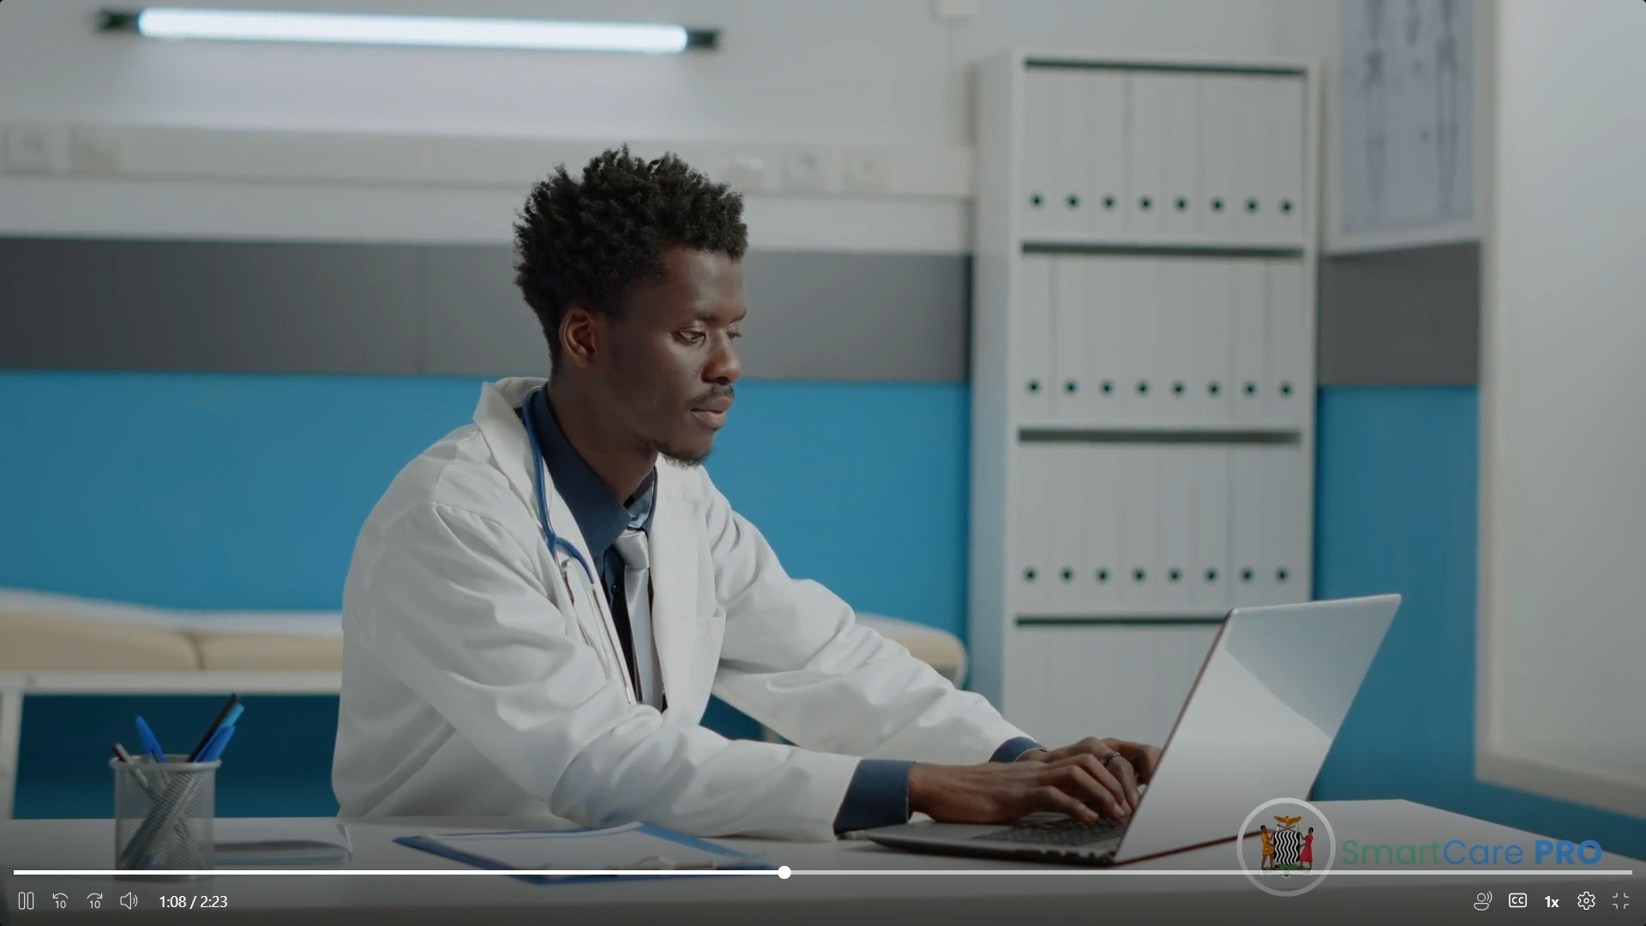
introduction
This job aid will outline the step-by-step process of how you can create a client profile including using Biometrics on a device or workstation.

Slide 3
objectives
At the end of this module, you are expected to be able to;
Log in securely using unique credentials, such as usernames and passwords.
To capture and store client biometric data during profile creation.
Enter client information with accuracy to prevent unauthorized access to sensitive medical records.

Slide 4
This is Jasper Chingaipe, Jasper is a Clinician at Kasanda Clinic. Jasper wants to create a client profile of Rhoda Mwale. Rhoda says she is not sure if she is registered with Smart CarePro or not. Hence, Jasper will have to login into Smart CarePro to determine if Rhoda is a registered client or not. The following are the steps Jasper is going to undertake to attend to Rhoda.

Slide 5
Step 1
Jasper will have to first login into Smart CarePro account as can be seen here.

Slide 6
Step 2
After logging in Jasper will select his facility and click the enter button.

Slide 7
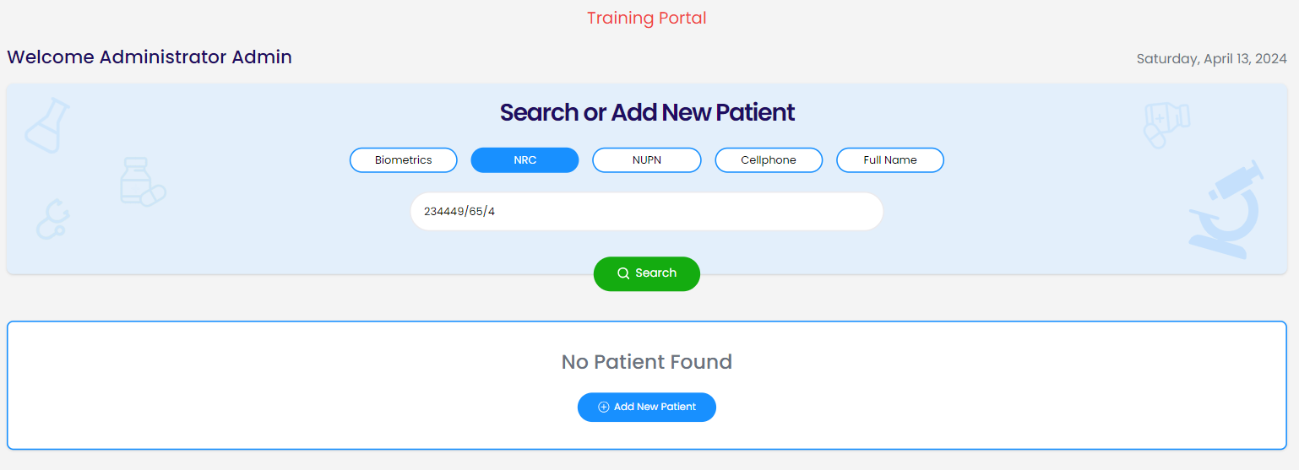
Step 3
Jasper will now search for Rhoda to see if she already exists in the database using there NRC, NUPN, Cellphone or Full Names.
If Rhoda does not already exist in the database, Jasper will have to click on Add New Patient as can be seen on the pictures.

Slide 8
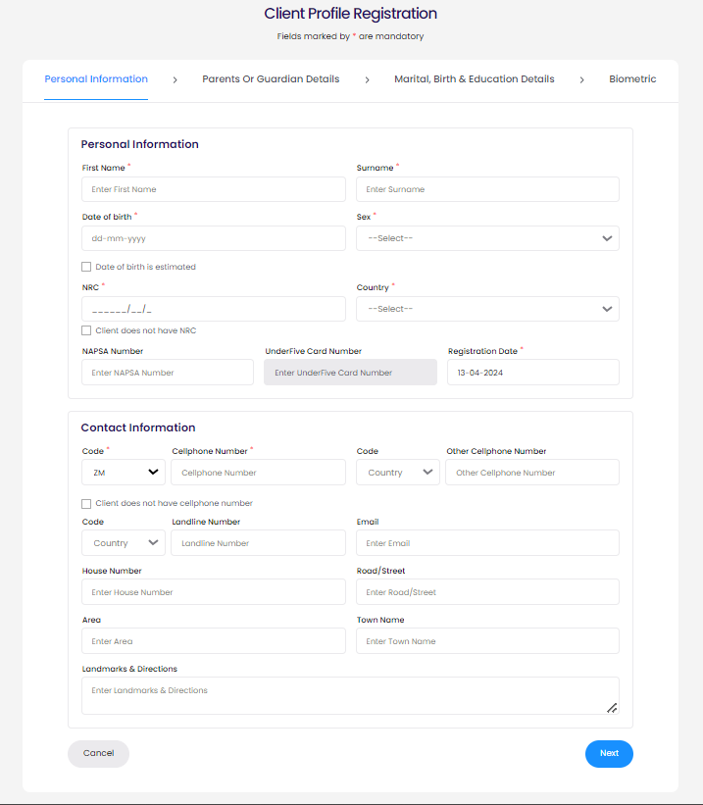
Step 4
Jasper will Proceed with the registration process by filling in the Rhoda’s details for each section and click Next.

Slide 9
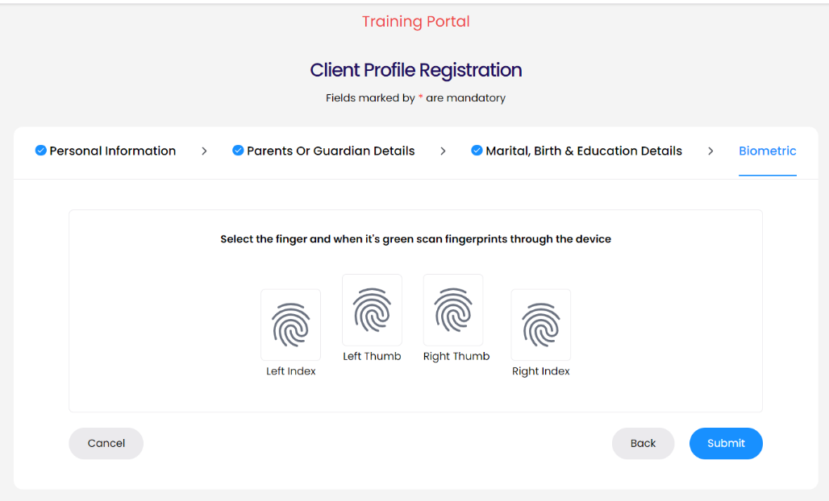
Step 4
After Jasper enters Rhoda’s personal, contact, parents/guardian, marital birth and education details, on the Biometric section, Jasper will need to have the M2sys device (fingerprint Device) Biometric Scanner connected to the workstation.

Slide 10
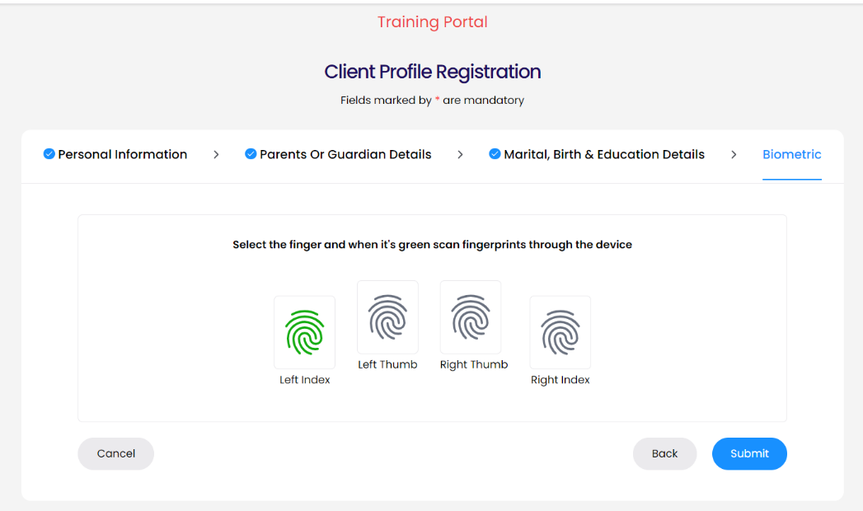
Step 5
Jasper will now ask Rhoda to click the fingerprint icon with a corresponding finger. When the icon turns green, Jasper will scan the corresponding finger through the device.

Slide 11
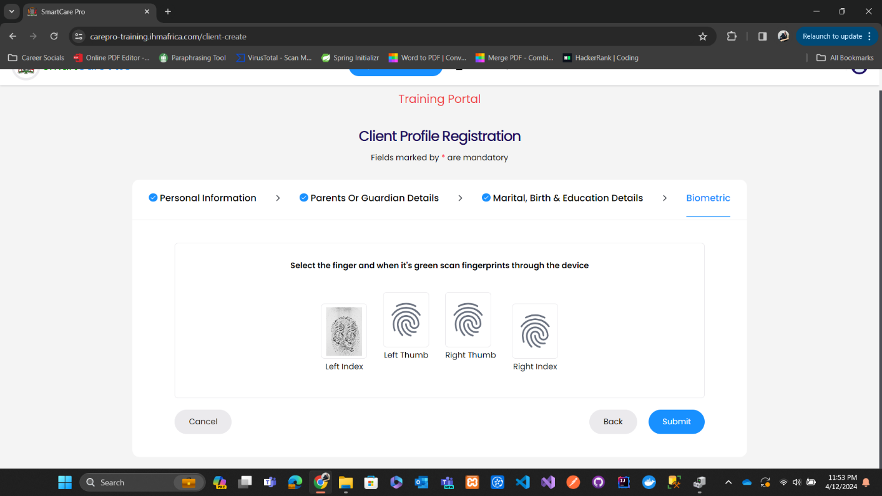
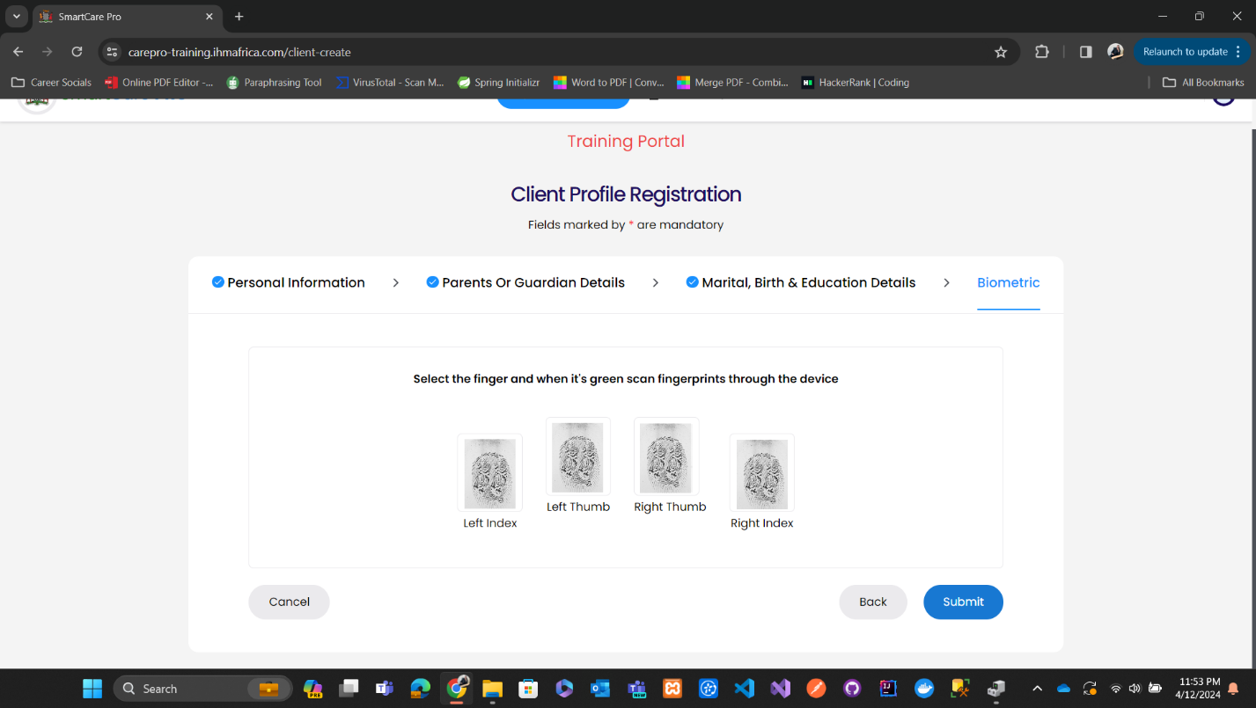
Step 6
After Jasper Scans the finger, an image of scan will be updated as shown on the first picture.
When all required fingers are scanned, Jasper will click on Submit.

Slide 12
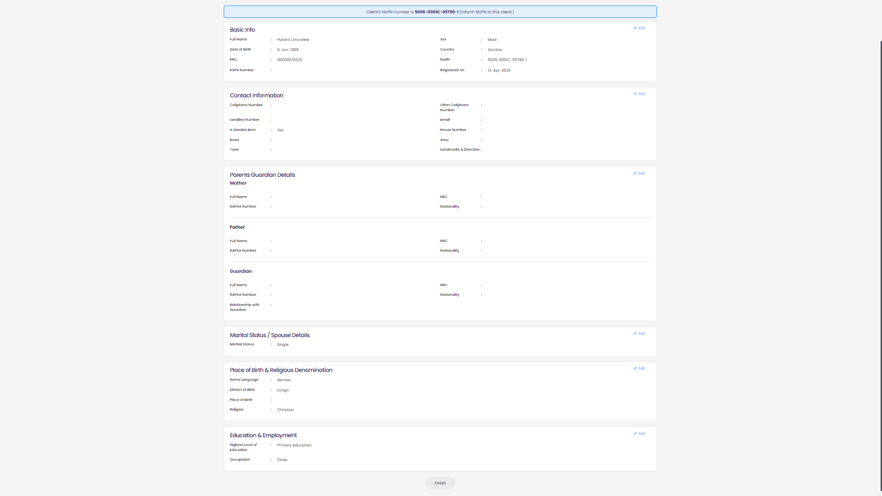
Step 7
After Jasper submits the form, he will have to verify Rhoda’s details. After verification, Jasper will click on Finish to complete Rhoda’s patient registration process. This will add her biometric records to the system.

Slide 13
Conclusion
By following the steps above, Jasper was able to successfully register Rhoda Mwale whose profile was not found in the system. In the registration process, Jasper included Rhoda’s biometrics using a fingerprint scanner device connected to his workstation.

