Slide 1
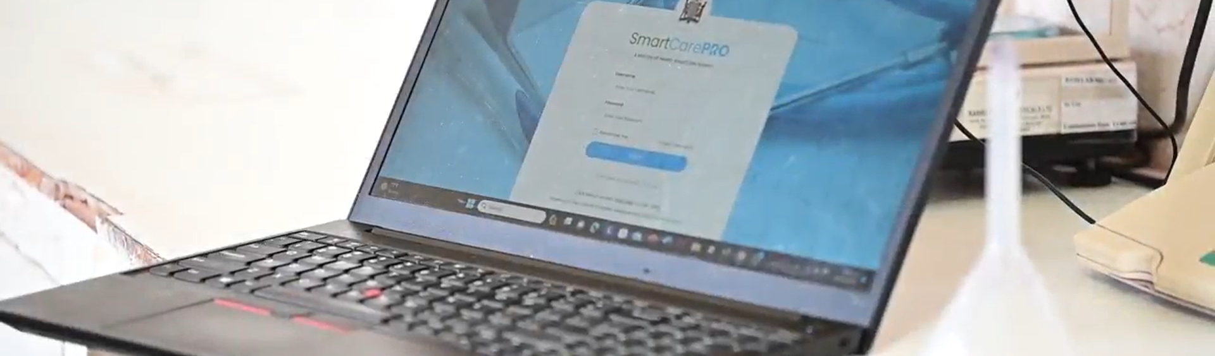
Smart Carepro biometrics
SEARCHING FOR CLIENT

Slide 2
introduction
One of the key features in Smart CarePro is Biometrics. This is a feature that allows users to search for a client using their fingerprint.

Slide 3
objectives
At the end of this module, you are expected to be able to;
locate client records in the database using their unique biometric data.
User-friendly interface for database administrators to input biometric data and initiate searches within the database.
Enhance data security

Slide 4
This is Wendy Chileshe who is a nurse at Kanyama level 1 hospital. Wendy has a client by the name of Katai kalumba. Mr. kalumba has come for his clinical follow up visit. Wendy will search for Mr. Kalumba using biometrics by following the steps that follow.

Slide 5
Step 1
To search for Mr. Kalumba, Wendy will use Biometric by clicking on the fingerprint icon until it turns green as can be seen on the picture. After turning green, scan the patients finger using the device.

Slide 6
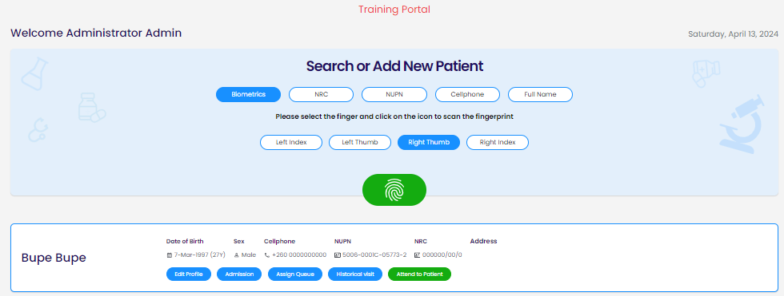
Step 2
If Mr. Kalumba’s biometric records are in the database, the system will retrieve his details as in the picture.

Slide 7
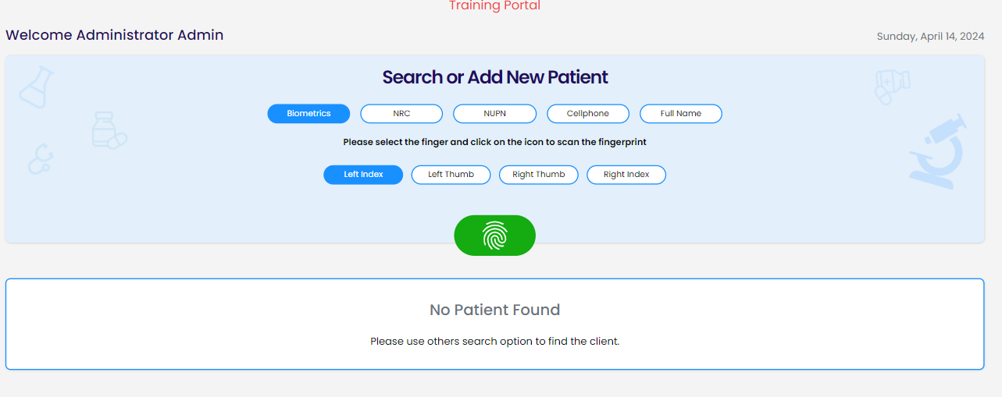
Step 3
If Mr. kalumba’s biometric records are not in the database, the system will indicate, ‘no patient found’.

Slide 8
conclusion
By following the easy steps above, Wendy was able to successfully search for Mr. kalumba and attend to him.

