Slide 1
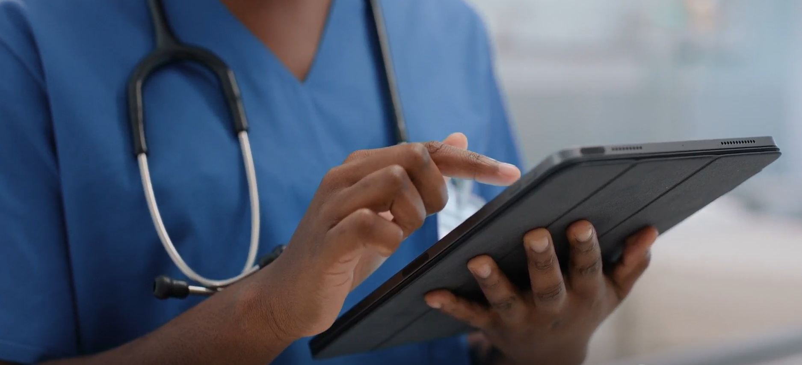
SMART CAREPRO TRAINING TRACKER
JOB AID

Slide 2
Introduction
Smart CarePro training tracker is a system developed and designed to automate and streamline the training process to enable easy monitoring, manage training progress, identify areas of improvement and draw action lines for pre and post-tests and ensure compliance with training regulations and standards.

Slide 3
Objectives
In this module you are expected to:
Understand the functions of the Smart Carepro training tracker.
Launch the URL on the browser and open the training tracker
Register and sign up and await access permission from the supervisor
Login and navigate through the system and discover the various features in the training tracker.

Slide 4
This is Agness Mwanza, Agness is a Smart CarePro Champion, and trainer based at Chunga Urban health center. Before Agness started her Smart CarePro training session, she is going to take us through the training tracker which is an online tracking tool for the Smart CarePro training activity. Agness will take us through the registration process, and how to login once you have registered.

Slide 5
Step 1
Once you load the browser it will take you to the landing page. You will login if already have an account. If you are a first-time user, click on register here as shown in the picture

Slide 6
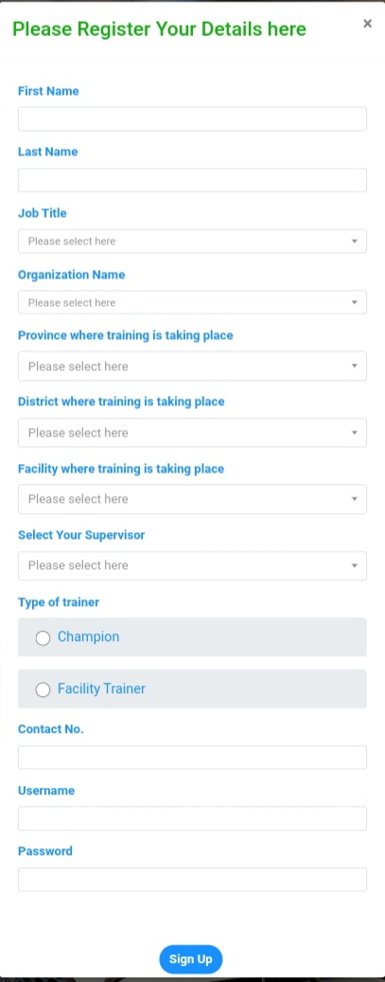
Step 2
Once you click on ‘register here’ this page as shown in the picture will open. On this page, fill in the details according to the prompts. Once you have filled in all the required details, click sign up.

Slide 7
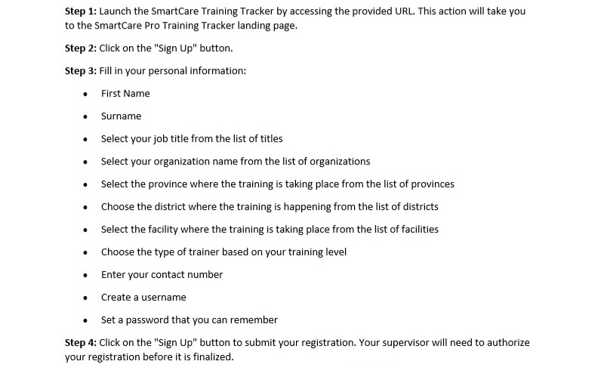
Here is a step-by-step guide you can follow for easy sign up

Slide 8
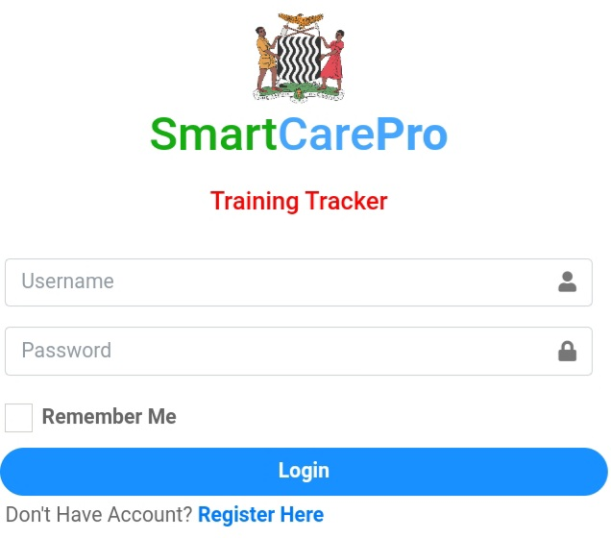
Step 3
Once you have successfully signed up and registered. An account will be created for you, and you will wait for access to be granted by your immediate supervisor. Once access has been granted, load the browser again and click on login.

Slide 9
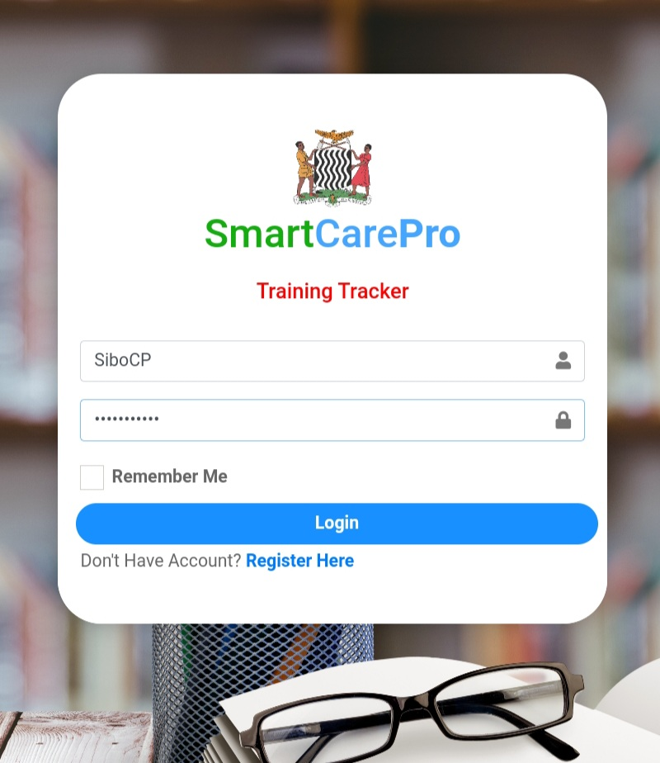
Step 4
To login, enter your username and password and click on login.

Slide 10
Step 5
Once you are logged in, you will land on the home page as seen in the picture. This is the master dashboard of the Training tracker. From here you can navigate the tracker using the various options availble.

Slide 11
Conclusion
In this module Agness Mwanza has taken you through 5 steps that will enable you to successfully register into the training tracker and login after creating an account.

